Slide 1
Case Study 1
📄 FashionWave Retail Store Sales Analysis Report

Slide 2
1. Executive Summary
FashionWave operates 50 stores across India.
Weekday sales are stable, but weekend sales are stagnant.
Objectives:
Boost weekend sales by 15% next quarter.
Improve product-level profitability.
Optimize discount strategies.

Slide 3
2. Dataset Overview
File: fashionwave_sales.csv
Columns:
InvoiceNo
Date
StoreID
ProductID
Category
Quantity
UnitPrice
Discount
CostPerUnit
CustomerType (New/Returning)
PaymentMode

Slide 4
3. Key KPIs
Total Sales: Weekly revenue per store.
Average Order Value (AOV): Revenue ÷ Transactions.
Profit Margin: (Revenue – Cost) ÷ Revenue.
Units Sold per Product: Category-level wise performance.
Discount Impact: Margin difference with vs. without discounts.
Weekend vs Weekday Ratio: Sales comparison.

Slide 5
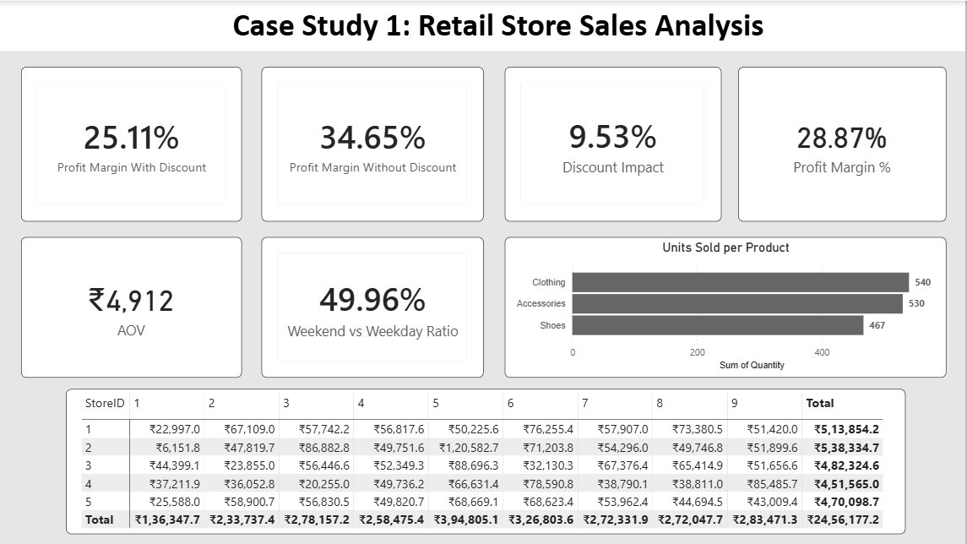
4. DASHBOARD

Slide 6
5. Visual Storytelling
Chart | Represents
Profit Margin Cards | Shows how discount reduces profit
Units Sold by Product | Identifies best and worst-selling categories
Store Revenue Table | Highlights top & underperforming stores
Weekend vs Weekday Ratio | Shows weak weekend contribution
AOV Card | Shows customer spending behaviour

Slide 7
6. Exploratory Data Analysis (EDA)
📊 Summary Statistics
KPI | Value | Insight
Profit Margin with Discount | 25.11% | Discounts significantly reduce overall profit.
Profit Margin without Discount | 34.65% | Baseline margin is healthy before promotions.
Discount Impact | 9.53% | Almost 10% margin loss due to discount strategy.
Overall Profit Margin | 28.87% | Indicates moderate profitability.
Average Order Value (AOV) | ₹4,912 | Customers are placing medium-value orders.
Weekend vs Weekday Ratio | 49.96% | Nearly equal contribution – no strong weekend dependency.

Slide 8
📦 Product Performance – Units Sold
Clothing & Accessories contribute nearly 70% of total unit sales.
Accessories are the highest revenue generator although 2nd highest contributor in sales.
Product Category | Units Sold | Insight
Clothing | 540 | Highest demand – primary revenue driver.
Accessories | 530 | Almost equal to Clothing – strong upsell category.
Shoes | 467 | Slightly lower – opportunity to improve promotions.

Slide 9
🏬 Store-wise Revenue Analysis
Store 2 is the top-performing store – best candidate for benchmarking strategies.
Store 4 underperforms compared to others — may need marketing or pricing review.
Store ID | Total Revenue
Store 2 | ₹5,38,334.7 (Highest)
Store 1 | ₹5,13,854.2
Store 3 | ₹4,82,324.6
Store 4 | ₹4,51,565.0
Store 5 | ₹4,70,098.7

Slide 10
7. Overall Business Health
Area | Status | Meaning
Profitability | ⚠ Moderate | Profit is affected due to high discounts
Sales Stability | ✅ Strong | Sales are consistent across time
Product Demand | ✅ High (Clothing & Accessories) | These are the top-selling categories
Discount Strategy | ❌ Needs Optimization | Current discount policy is reducing margins
Store Performance Variance | ⚠ Medium | Some stores perform better than others
Weekend vs Weekday Ratio | ⚠ Average (≈50–50) | No strong weekend boost — growth opportunity exists

Slide 11
8. Recommendations
Problem Found | What It Means | Simple Action
Profit margin drops due to discount | Too much discount is reducing profit | Stop giving discount on all products
Shoes have low sales | Customers buy fewer shoes | Give more offers only on Shoes
Clothing & Accessories sell more | These products are in high demand | Keep price stable, reduce discount
Store 4 earns less revenue | Store 4 is underperforming | Improve promotion & product variety in Store 4
Average order value is ₹4,912 | Customers buy few items per order | Create combo offers to increase bill value
Limited product-level insights | Data is available only at category level (e.g., Clothing) | Request sub-category data (e.g., T-shirts, Jeans, Jackets) for deeper analysis

